Slide 1

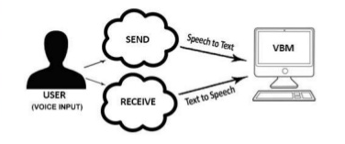
D.Y.PATIL COLLEGE OF ENGINNERING & TECHNOLOGY KASABA BAVADA, KOLHAPUR DEPARTMENT OF COMPUTER SCIENCE AND ENGINEERING (Academic Year:- 2022-2023) “Voice Based E-mail System””
Sr.no | Name | Roll No.
1 | Sahil Kiran Kamble | 41
2 | Anuj Uttam Gangane | 42
3 | Rishikesh Randheer Kamble | 44
4 | Rohan Ashok Chougule | 45
5 | Rohit Anjaiah Erugurala | 46
Under the guidance of
Prof.Mr. Niraj Haval
Class –TY.Btech Div:-B

Slide 2
Introduction
Email are performing much more important role in todays life .As there are many fields where the emails are sent and recived multiple times.It is need today to make much easier email sending procedure.
The most common mail services that we use in our day to day life is totally based on the typing. In that system we have to type whole mail using keyboard but we did the something different in the email system as we have developed PC based software, in which we are composing the whole mail using voice .
In this project we are going to develop PC based software which will help the peoples to use email services efficiently as reducing the efforts of typing and saving their time. This system is specially helpful for people to use there emails in easier way.
This PC based software created using Python ,file handlind and tkinker for storing data.

Slide 3
Problem Statement
Developing Voice Assistant For Email System to send the mails in easier way.

Slide 4
Need Of Work
There are more people around the global who needs to use the email multiple times in a day. So they while composing the mail more time is utilized and it takes more efforts of typing ,
As if we do some voice based changes then some efforts of typing will get reduced as voice based line printing will do help in this.
As it is very useful to send the mails multiple times with easier way.

Slide 5
Objectives
The main objective of the Voice based email System is to make user friendly email sending procedure . This system is very useful to a people to reduce their efforts of typing and to save their time.
Basically this application is permforming role as voice assistant for email service

Slide 6
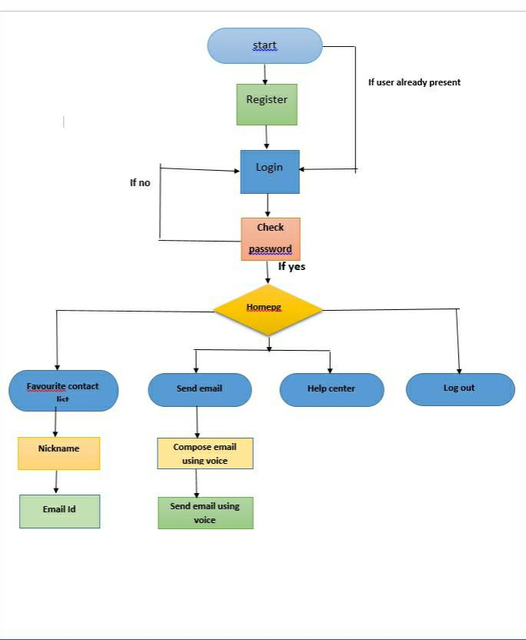
Proposed System Architecture

Slide 7
flow chart of voice based email
Voice based email system
NO
Want to send email
Sender email id
YES
Receiver email id
Sending email successfully
Want to send email again
NO
Log out

Slide 8
Functions & Modules
PC based application
User details for new entry
Login
Registration
Home page
Favourite contact list
Send mail
Voice based email sending Procedure
Help
Log out

Slide 9
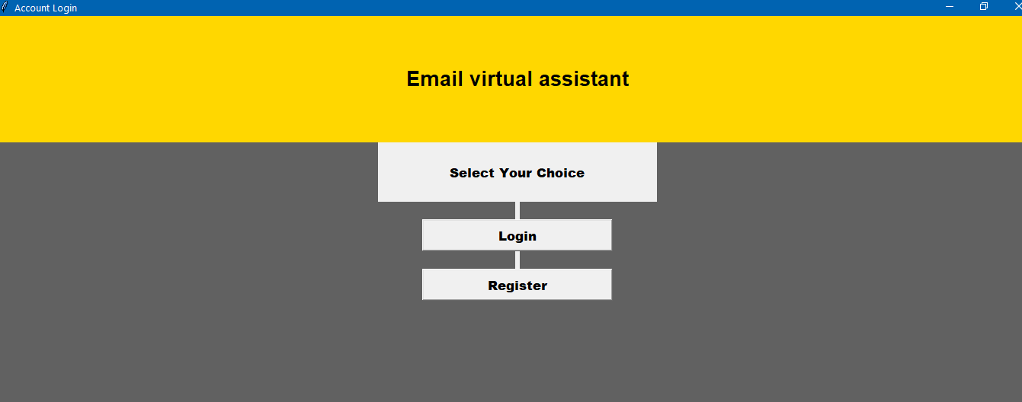
Execution process for application
INPUT: Start the application:
Output:

Slide 10
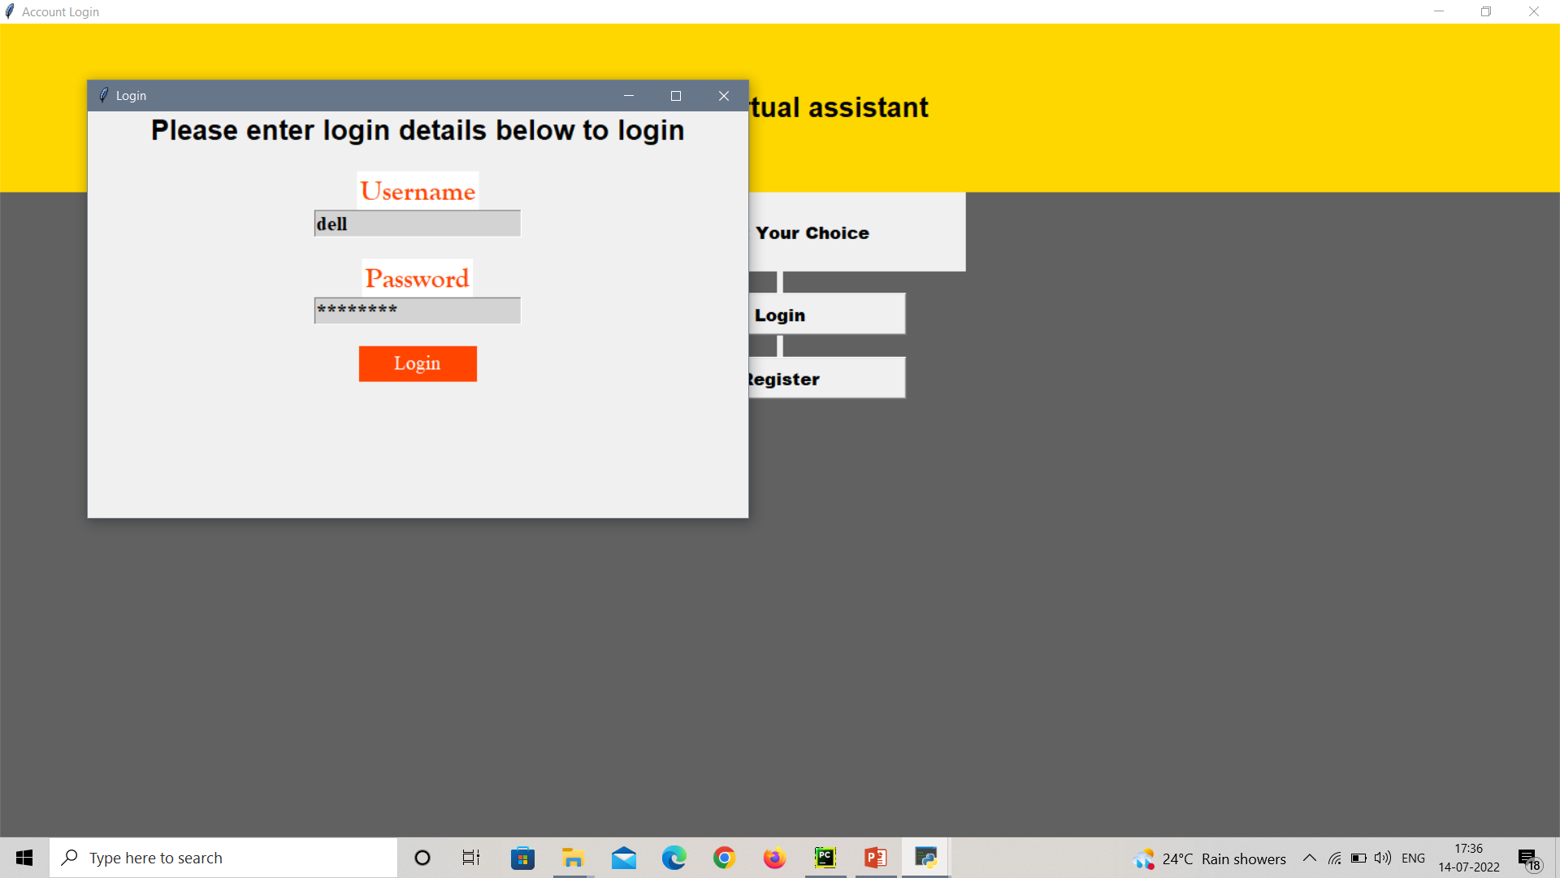
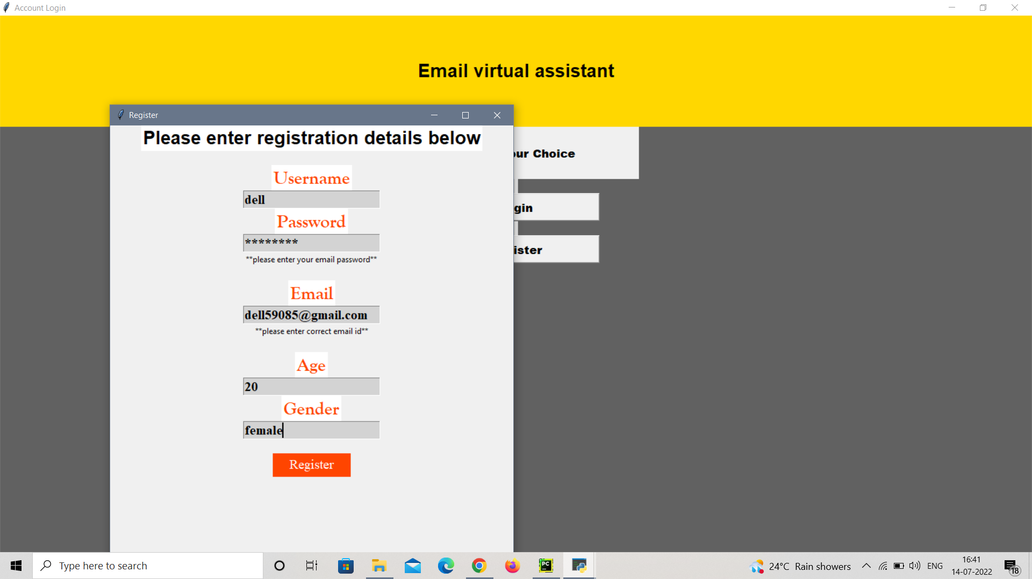
Input: Registration and Login
Output:

Slide 11
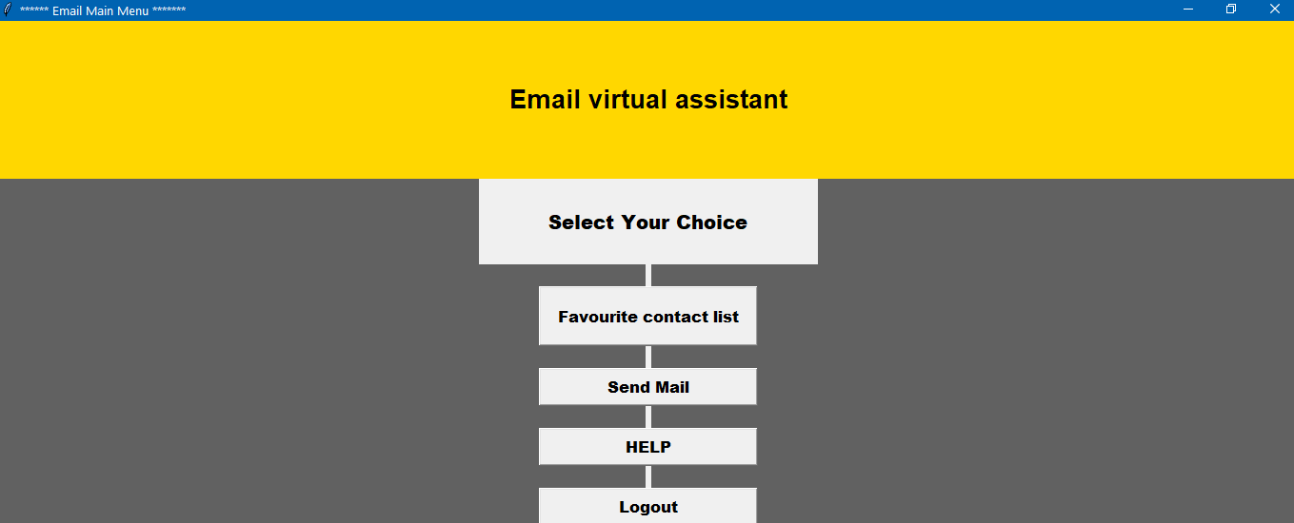
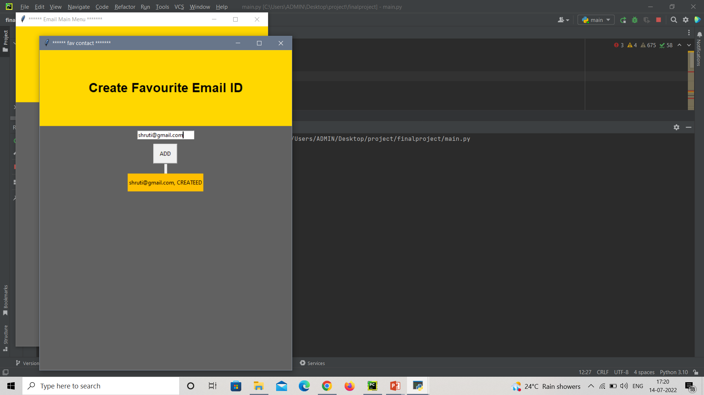
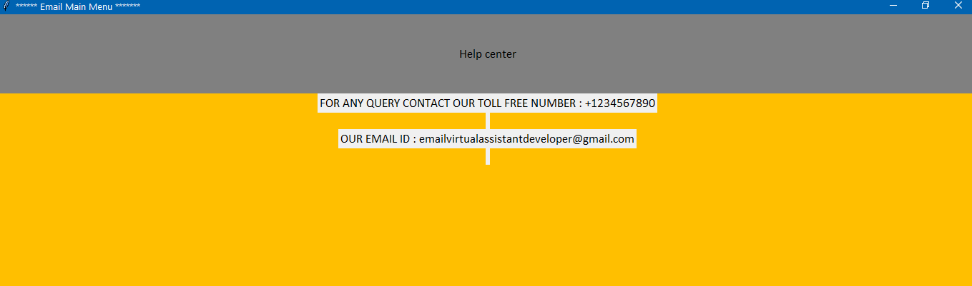
Input: Main Screen / Favourite Contact list / Help Center /Log Out
Output:

Slide 12
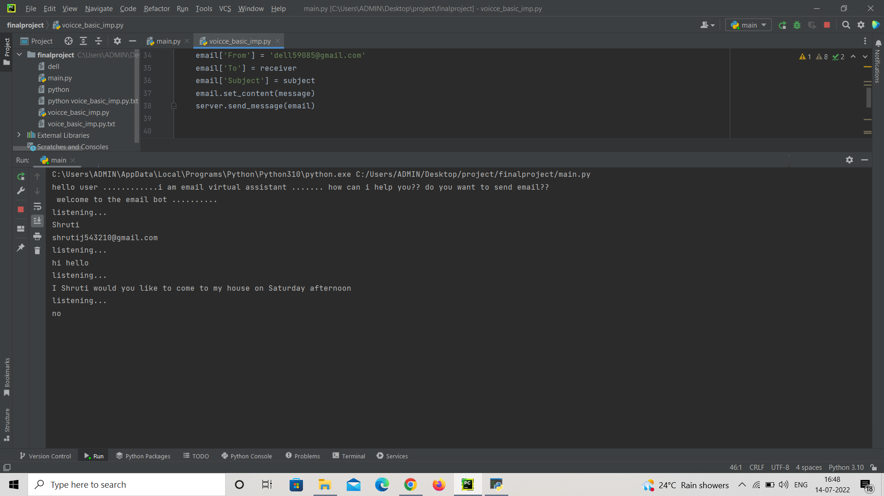
Input: SEND EMAIL
Output:

Slide 13
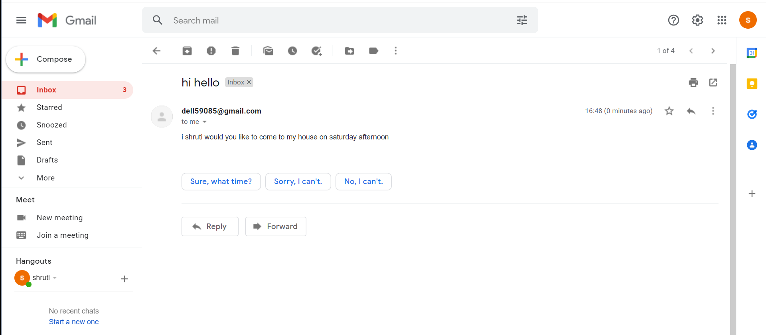
“EMAIL VIRTUAL ASSISTANT”

Slide 14
Implementation Details
Hardware Requirement:-
Memory Space:
[A] Minimum = 4GB
[B] Recommended = 8GB
Hard Disk Driver = To install the software at least 2 GB & the data storage is depending upon the organizational setup.
Processor = Intel core i3 and above.
RAM = 4gb or above
Software Requirement:-
Operating System = Windows
Developing Language = Python
Software = Python 3.9, Pycharm /Jupiter notebook/ Visual studio .

Slide 15
Conclusion
In this project we have proposed a system which will help the peoples to access email services efficiently. This system will help in overcoming some drawbacks that were earlier faced by the people to whom have to use the mails multiple times in a day. The user only needs to follow the instructions given in the software and use mouse clicks accordingly to get the respective services offered. We are providing feature in which users just sends email using voice.

Slide 16
Reference
Books:-
[1] Jagtap Nilesh, Pawan Alai, Chavhan Swapnil and Bendre M.R.. “Voice Based System in Desktop and Mobile Devices for Blind People”. In International Journal of Emerging Technology and Advanced Engineering (IJETAE), 2014 on Pages 404-407 (Volume 4, issue 2).
[2] Ummuhanysifa U.,Nizar Banu P K , “Voice Based Search Engine and Web page Reader”. In Internationa Journal of Computational Engineering Research (IJCER). Pages 1-5.
Websites:-
https://www.seminarsonly.com/Engineering-Projects/Computer/voice-based-email-system.php
https://www.geeksforgeeks.org/project-idea-voice-based-email-visually-challenged.com

Slide 17
Thank You…..

